Slide 1
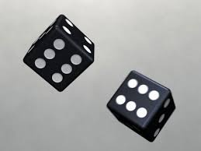
Advance statistical methods and data analysis for neuroscience

Slide 2
Sources
Probability and Statistics by DeGroot & Schervish
The internet (Wikipedia)
https://onlinecourses.science.psu.edu/stat414/node/234
http://stattrek.com

Slide 3
Today Lesson
Introduction and motivation…
Probability
Common probability distributions
Binomial
Poisson
Hypergeometric

Slide 4
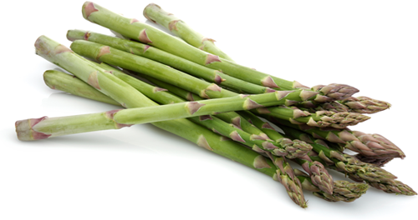
Statistics is everywhere
Would it rain today?
Should I guess the loto to be 1,2,3,4,5,6?
Eating asparagus relief headache

Slide 5
What is statistics?
Descriptive statistics
Describe the main data parameters (e.g. mean, variance, modes etc)
Inferential statistics
Use the data to infer on new unseen samples

Slide 6
Several neuroscience examples:
Is there a neural response to a stimulus?
When is the response started/ended?
Is there a difference between two brain regions?

Slide 7
Why we need to learn statistics? Intuition can be misleading

Slide 8
The Monthly Hall Problem
May I suggest that you obtain and refer to a standard textbook on probability before you try to answer a question of this type again? Charles Reid, Ph.D. University of Florida
You made a mistake, but look at the positive side. If all those Ph.D.’s were wrong, the country would be in some very serious trouble. Everett Harman, Ph.D. U.S. Army Research Institute
Maybe women look at math problems differently than men. Don Edwards Sunriver, Oregon

Slide 9
Example
Assume some type of cancer has a rate of: 1/1000
Assume a test for cancer tested on 1000 cancerous and non-cancerous samples has the following false positive and false negative rates
What is the probably of having cancer if the test was positive?
Answer: ~8.6% (because 1 out (10+1) positives is really sick)
Sensitivity specificity
Test result | Cancer | No Cancer
Positive | 950 (Hits) | 10 (FP)
Negative | 50 (FN) | 990 (FR)
Total | 1000 | 1000

Slide 10
Intuition can be misleading
During your PhD you found an interesting effect using n=20 subjects and you have a significant result which confirms your theory (z = 2.23, p < 0.05)
Your mentor wants to be sure and ask you to run the test again with n=10.
What is the probability that the result will be significant?
Solution: 0.48 !!! (don’t do this experiment ☺)

Slide 11
Intuition can be misleading
Each day for 7 working days you receive an email telling you if some stock will go up or down.
You check these predictions and find them precise!
Should you pay the company for future predictions?

Slide 12
Syllabus
Part I: Basic Parametric Tests
Major probability distributions
Normal distribution and Z value
The central limit theorem
Confidence interval
Hypothesis testing
t-distribution, degree of freedom
Proportion test
2-samples tests (paired and unpaired)
Part II: Non-Parametric Tests
Wilcoxon test
Permutation test
Bootstrapping
Chi-square
Kolmogorov-Smirnov test
Analysis of variance
Multiple comparison
False discovery rate
F test
Circular statistics
מטרת על: רכישה של חשיבה סטטיסטית

Slide 13
How do we learn
2 hours lesson
2 hours exercises
Homework to be submitted the week after
Tal Dalal is your BODEK
Each weak we will go over the last week exercises
Each student will solve one exercise
Final assignments:
Exam
Score is based on:
Exercises, course participation, exam

Slide 14
1. What is Probability?
Frequency of occurrence.
The relative frequency of event occur is the process is repeated a large number of times under similar conditions
Problem with this approach
What is large?
What is similar conditions?
What about events that can not be repeated (will my friend will marry this year)?

Slide 15
2. What is probability?
The classical approach
Two events that have equally likely outcomes has the same probability (0.5)
Problems
It is circular definition (equally likely is the same as saying they have the same probability)
What about events that are not equally likely?

Slide 16
3. What is probability
The subjective approach
A probability of an event is the subjective estimate of one person that this event will occur

Slide 17
Probability – basic staff
Definition: the collection of all possible outcomes of an experiment is called the sample space
If all events have equal probability then the probability of each event is 1/n
The probability of one of the events to occur is the ratio of the number of events and the size of the sample space
This brings us to the basic tools of counting outcomes
P = 3/8

Slide 18
Counting methods
We have n different elements
How many possible arrangements there are for the n different elements?
Solution:
n!

Slide 19
Counting methods
We choose k elements from n different elements without replacements
If the order of the k elements is important
Pn,k=$\frac{n!}{\left(n−k\right)!}$
If the order of the k elements is not important
Cn,k=$\frac{n!}{\left(n−k\right)!k!}$
In matlab nchoosek(n,k)

Slide 20
Counting methods
We choose k elements from n different elements with replacements
How many possible different selections ?
Solution:
n^k

Slide 21
Example
What is the probability of getting 2 heads in 3 tosses of a fair coin?
Solution:
There are 2^3=8 possible coins sequences
There are nchoosek(3,2)=3 sequences with 2 heads
HHT
HTH
THH
Therefore p = 3/8

Slide 22
Example
We have a box with the numbers 1 to 10
We select 3 numbers with replacement
What is the probability to have 3 different numbers?
Solution:
The sample size is: n^k = 10^3
The event group size is: $\frac{n!}{\left(n−k\right)!}$=nchoosek(10,3)*3!
P = nchoosek(10,3)*3!/10^3=0.72

Slide 23
Alternative approach
We have 10 possibilities to select the first number
Once we selected it the probability of not selecting this number is 9/10
Same for the third
We get:
P=10/10*9/10*8/10=0.72
This approach is very usefull…

Slide 24
The famous birthday problem
What is the probability that in a group of 15 people there will be at least two people with the same birthday (day/month)?
Solution:
We need to compute the probability that all people birthdays are different and subtract from one
This is the same as the previous problem
Number of possible k dates is n^k
Number of selecting k different dates is (order is important) : $\frac{n!}{\left(n−k\right)! }$
Thus P = $\frac{n!}{\left(n−k\right)!n^{k}}=$
$nchoosek(365,15)∗factorial(15)/365^15$ = 0.74
So p = 1-0.74 = 0.26

Slide 25
Example
How many binary series of length n have k ones ?
Solution:
We need to select k locations out of n in which we place the 1’s
We do not care about their order
So: $\frac{n!}{\left(n−k\right)!k!}$

Slide 26
Important probability distributions
Binomial
Poisson
Hypergeometric
Normal
(Exponential)
Chi square
F

Slide 27
Binomial distribution

Slide 28
Binomial distribution
The binomial distribution with parameters n and p is the discrete probability distribution of the number of successes in a sequence of n independent yes/no experiments, each of which yields success with probability p. (Wekipedia)

Slide 29
Binomial
Binomial is a discrete probability
N identical trials
Each trial has one of two outcomes
The probability of success on a single trial is the same: π
Trials are independent

Slide 30
Binomial
We want k successes and n-k failures

Slide 31
Example
The probability of a neuron to respond to a specific stimulus is 0.9
What is the probability that it will not respond to 3 out of 10 trails ?
π = 0.9
N = 10
K = 7
P (k=7) = 10!/(7!*3!)*0.9^7*0.1^3 = 0.05
10!/(7!*3!)=nchoosek(10,3)

Slide 32
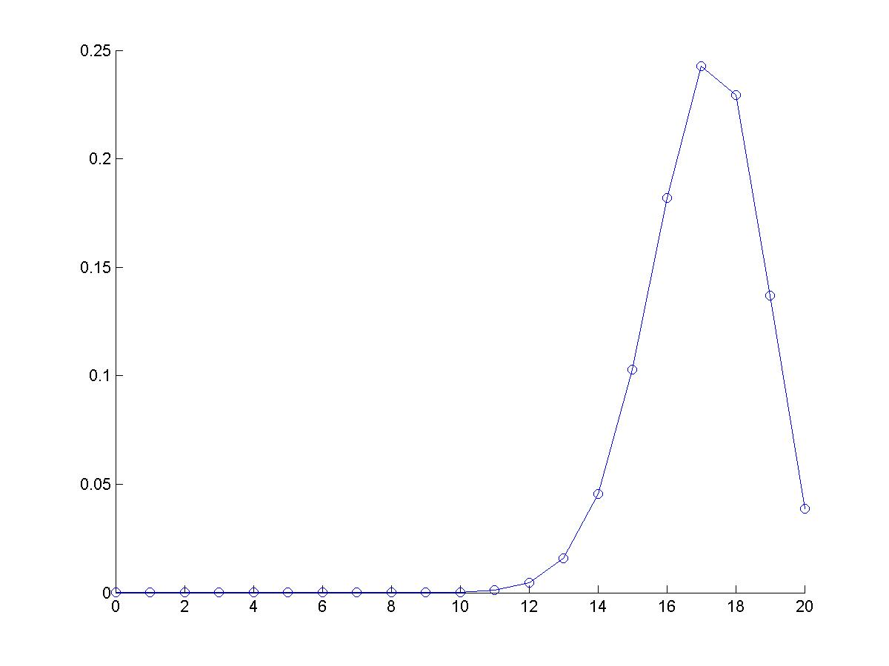
PDF versus CDF p = 0.85, n = 20
PDF – Probability Distribution
Function: p(x = k)
CDF - Accumulative Distribution
Function: F(k) = p(x≤k)
Probability
K
K

Slide 33
Example
The rate of seeds germination is 0.85
If we test 20 seeds we should expect to have
µ = 20*0.85 = 17 germinating seeds on average
σ = sqrt(20*0.85*0.15) = 1.59
Assume we got only 14 out 20 that germinated. Is this “reasonable”?
Lets define “reasonable” that there is a <5% chance that this result is just bad luck
Solution
P = binopdf(14,20,0.85) = 0.045
P = binopdf(17,20,0.85) = 0.24
But we actually need to compute binocdf(14,20,0.85) = 0.067 ,
Still unlikely a random error, we may conclude we have a problem with the seeds!

Slide 34
Example continue
%% binomial probability
r=[];
p=0.85;
n=20;
for k=0:20
r(end+1) =nchoosek(n,k)*p^k*(1-p)^(n-k)
end
figure
plot(0:20,r, '-o')
box off;
µ = 17
σ = 1.6
Probability
Accumulative distribution
function: p(x<k)
P<0.05
Mean
Number of germinations
y=cdf('binomial', 0:20,20,0.85)

Slide 35
Binomial distribution
Probability
If p is not “too extreme” then binomial looks normal
(we check that n*p is “not small”)
binopdf(0:10, 10, p)

Slide 36
Poisson distribution

Slide 37
Poisson distribution
A discrete distribution
Model the events of a particular event over a unit of time or space
Examples:
The number of cars arriving to a toll in a given time interval.
The number of waste particles in one liter sampled from a river
Spikes fired by a neuron at a given time interval

Slide 38
Poisson: conditions
Events occur one at a time
Events are independent (if an event occur it does not effect the probability of later events)
The expected number of events, µ, is the same for all time intervals or regions of interest.
The probability of observing k events is:
u is the mean and variance

Slide 39
Example
A neuron average firing rate is 2.3 spikes/sec
What is the probability of observing at most 4 spikes/sec ?
Solution
P(k≤4) = P(k=0)+ P(k=1)+ P(k=2)+P(k=3)+P(k=4) =
And for P(k<10) = 0.9999
So it is unlikely this neuron will fire more than 10 spikes/sec

Slide 40
Examples
The number of service calls HOT receives per hour per person during the morning is 20.
You call HOT and you hear that you are number 40 on the line
Is it likely a fluctuations or HOT just reduced (again) the number of service persons?
Solution
u = 20
P(K >= 40) = 1-poisscdf(39,20) = 2.5e-5
Obviously…

Slide 41
Hypergeometric distribution

Slide 42
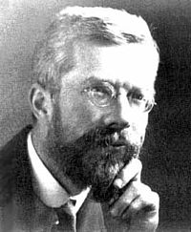
Hypergeometric distribution: Fisher exact test: the lady testing tea story
Miss Muriel Bristol claimed to be able to the tell whether the tea or the milk was added first to a cup
Eight cups test; 4 of each type
The women needs to point on 4 of the same type
The possible choices are:
The probability is 1/70=0.014
Alternativly:4/8*3/7*2/6*1/5 = 1/70
R. Fisher
1890-1962, UK

Slide 43
Example
Group of 4 women and 6 man
We select 3 people for the management, what is the probability of having exactly 2 men?
Solution #1:
(m,m,w) = 6/10*5/9*4/8
(m,w,m) = 6/10*4/9*5/8
(w,m,m) = 4/10*6/9*5/8
Total = 0.5
Solution #2:
Hypergeometric distribution
“Binomial without replacement”

Slide 44
Fisher exact test: contingency table Selecting management
 | men | women | Total
selected | 2 (k) | 1 | 3 (K)
Not selected | 4 (n-k) | 3 | 7 (N-K)
 | 6 (n) | 4 | 10 (N)
= $\frac{\left({6 \atop 2}\right)\left({4 \atop 1}\right)}{\left({10 \atop 3}\right)}$

Slide 45
Fisher exact test: contingency table The tea problem
 | Tea first | Milk first | Total
Guess tea first | 4 (k) | 0 | 4 (K)
Guess milk first | 0 (n-k) | 4 | 4 (N-K)
 | 4 (n) | 4 | 8 (N)

Slide 46
Fisher exact test Hypergeometric distribution contingency table
Population | Success | Failure | Total
A | k | K – k | K
B | n – k | N - K – n + k | N - K
Total | n | N – n | N
N is the population size
K is the number of success states in the population
n is the number of draws
k is the number of successes
We might need:
Matlab:
[h,p,stat]=fishertest([colum1; colum2])

Slide 47
Hypergeometric distribution
Sampling n elements out of N
K of the elements are of category ‘C’ and N-K are not
We draw n elements without replacements
What is the probability to get exactly k elements of category ‘C’?
This is different from binomial distribution because it is without replacements. So the probability to get a success changes after every draw

Slide 48
Example
Drug | Success | Failure | Total | Proportions
PV | 38 | 4 | 42 | 90%
P | 14 | 7 | 21 | 66%
Total | 52 | 11 | 63
A clinical trial compared two drugs P and PV
They tested 42 people with PV and 21 with P
Is there significance evidence that PV is better then P (note: we actually ask if 90% > 66%)
We use the fisher exact test
And we need:
[h,p,stat] = fishertest([38 14; 4 7])
h=1; p= 0.032

Slide 49
Continue
To claim that P is different than PV we need to the probabilities of all ‘bad’ tables:
38 4 42
14 7 21
52 11 63
----------
39 3 42
13 8 21
52 11 63
---------
40 2 42
12 9 21
52 11 63
-----------
41 1 42
11 10 21
52 11 63
-----------
42 0 42
10 11 21
52 11 63

Slide 50
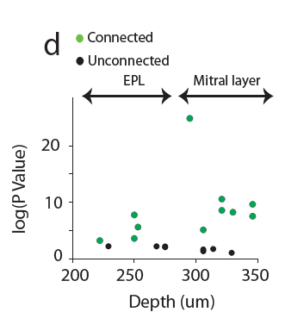
Example: connected and unconnected neurons
11 connected
7 unconnected
7 in the mitral layer
4 in the EPL
Are connected more common
in the mitral layer?
Solution:
 | connected | unconnected | Total
Mitral layer | 7 | 4 | 11
Epl | 4 | 3 | 7
total | 11 | 7 | 18

Slide 51
Hypergeometric distribution General case
We have N marbles in a urn
We have K_{i} from color _{i}
We peak n marbles without replacements
What is the probability of getting k_{i} of each color?

Slide 52
Summary of Today Lesson
Introduction and motivation…
Probability
Common probability distributions
Binomial
Poisson
Hypergeometric
Concepts:
PDF and CDF
Next lesson: the normal distribution

